Slide 1
TOPIC A:
DATABASES
LESSON A-1
INTRO TO DATA & DATABASES

Slide 2
AGENDA
Data
Information
Databases
Database Needs
NOTE!
Have a way to take notes available for this lesson

Slide 3
DATA
Data comes in many shapes and sizes
Integers
Text (strings)
Boolean
Computers simply store this data, they don’t have any additional context or information about it

Slide 4
DATA
If I was to spit out this list of numbers:
30, 22, 09, 02, 04, 14, 26, 08
What’s your first thought?
These numbers have no inherent meaning to them, do they?

Slide 5
DATA
This data could represent a few things
ASCII values
Scores earned in the last 8 throws in darts
Temperature of 8 cities around the world at 12:00 PM today in Celsius
Ages of the last 8 people to enter the Dallas Zoo
What else?

Slide 6
INFORMATION
This supporting information provides context for the data provided
Through this, our data now has meaning, it represents something in our world, or outside of it
The data has become information

Slide 7
DATA
It is important to know that databases only store data, and very small amounts of information describing what that data may be
These terms are often used interchangeably (data and information) as there is often an assumption that the data stored in databases is only stored because it is of relevance as information
Used by the people who constructed the database

Slide 8
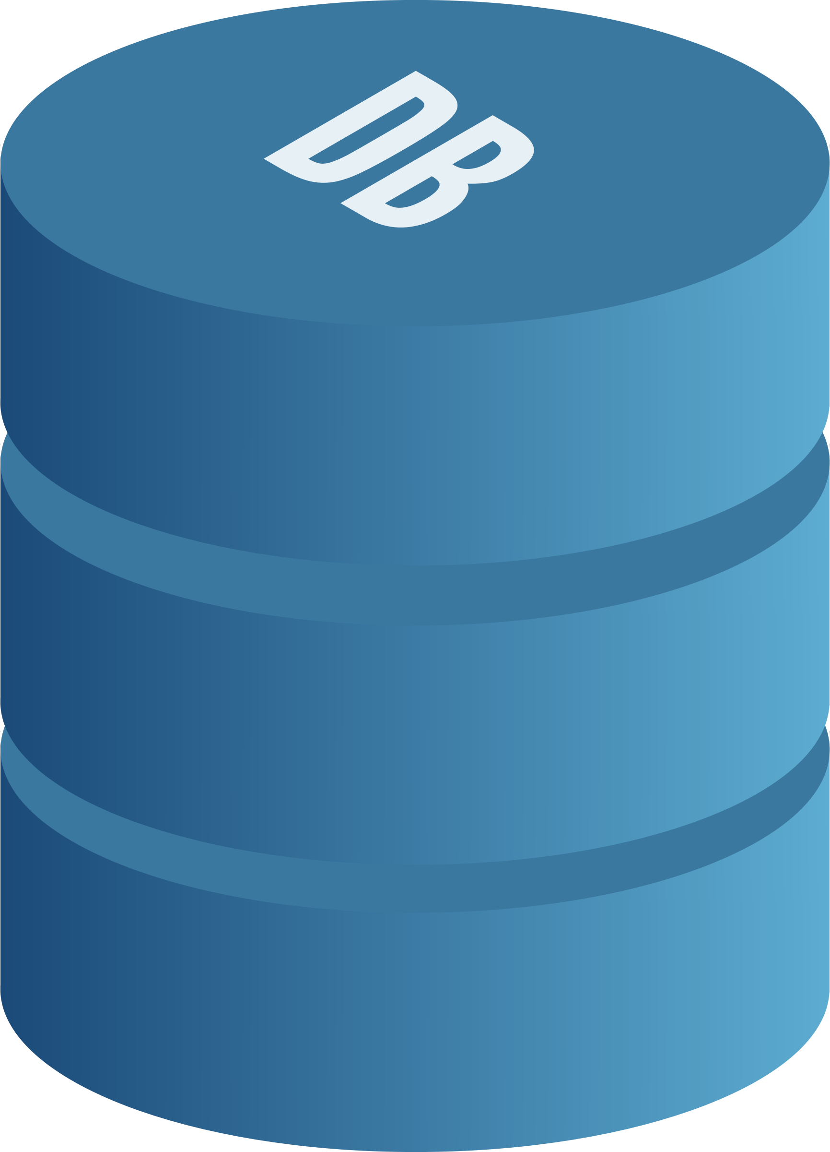
DATABASES
Databases refers only to the data part of an information system, they rarely exist on their own
Databases are rigidly structured sets of data held in computer systems
They are generally much more robust at storing data than alternatives like text files and spreadsheets
Consequently, they take much, much more effort to create and maintain

Slide 9
DATABASE NEEDS
As data scales, alternatives like spreadsheets become unmanageable
What might happen as a business using a spreadsheet grows to thousands, or even hundreds of thousands of customers?

Slide 10
DATABASE NEEDS
Databases are built to store millions of records at once and retrieve them very quickly to help with scaling up operations
Using spreadsheets for this purpose genuinely may crash your computer

Slide 11
DATABASE NEEDS
What happens if multiple branches of a company need to take down information about customers all at the same time?
(Google sheets kind of fixes this issue but the curriculum was written before google sheets existed lol)

Slide 12
DATABASE NEEDS
Databases allow for multiple updates to occur at once, only having problems if multiple people change the same specific piece of data

Slide 13
DATABASE NEEDS
What happens when you put a letter in the date field?
What happens if you put an invalid character in somebody’s name
Imagine that a second program runs based on this spreadsheet, what may happen to it?

Slide 14
DATABASE NEEDS
Databases enforce accuracy of data fields
Date fields must be populated by a correctly formatted data
Incorrect entries will be rejected and asked to try again

Slide 15
DATABASE NEEDS
What happens if a malicious actor gets into the computer where you’re storing your spreadsheet?

Slide 16
DATABASE NEEDS
Databases can enforce user accounts using login, as well as additional security measures, such as deletion protection
Databases can allow only certain users to see certain kinds of information
Databases can encrypt information like passwords so that even if they are breached the passwords remain safe

Slide 17
DATABASE NEEDS
What happens if your computer gives up the ghost with the spreadsheet on it?

Slide 18
DATABASE NEEDS
Databases allow you to have multiple copies of the data on them in multiple locations, as well as backups at one single location
These can be switched over to similarly to failover systems as we discussed in Topic 1, and to have a proper failover system for an organization that uses a database you will need a backed up database

Slide 19
DATABASE NEEDS
What happens if your computer crashes while you’re in the middle of entering data?
When you boot it back up, your automated program may start trying to run with incomplete data

Slide 20
DATABASE NEEDS
Databases prevent entries from being made that do not satisfy all required fields, and if one is attempted, it is immediately reverted so we can be sure that every listing in the database is complete and workable

Slide 21
DATABASE NEEDS
Long story short, a database is necessary for an organization that stores a lot of data

Slide 22
DISCUSSION
How big do you think an organization needs to be before they switch over from a spreadsheet to a database?
What are the downsides to waiting a while to switch to a database from a spreadsheet?
What are the upsides of waiting to switch from a spreadsheet to a database?

